Slide 1
Distance magic and group distance magic graphs Report on work in progress (and a few dead ends)
Dalibor Froncek
University of Minnesota Duluth

Slide 3
Incomplete round robin tournaments

Slide 4
Incomplete round robin tournaments
What if we have 8 teams but not enough time to play a complete tournament?
Say we can play only 4−6 games per team.

Slide 5
Incomplete round robin tournaments
What if we have 8 teams but not enough time to play a complete tournament?
Say we can play only 4−6 games per team.
What games we choose, if the teams are ranked according to their strength?
We have several options:

Slide 6
Incomplete round robin tournaments
What if we have 8 teams but not enough time to play a complete tournament?
Say we can play only 4−6 games per team.
What games we choose, if the teams are ranked according to their strength?
We have several options:
All teams have the same strength of schedule

Slide 7
Incomplete round robin tournaments
What if we have 8 teams but not enough time to play a complete tournament?
Say we can play only 4−6 games per team.
What games we choose, if the teams are ranked according to their strength?
We have several options:
All teams have the same strength of schedule
The tournaments mimics the complete tournament (strongest team has easiest schedule)

Slide 8
Incomplete round robin tournaments
What if we have 8 teams but not enough time to play a complete tournament?
Say we can play only 4−6 games per team.
What games we choose, if the teams are ranked according to their strength?
We have several options:
All teams have the same strength of schedule
The tournaments mimics the complete tournament (strongest team has easiest schedule)
All teams have the same chance of winning (weakest team has easiest schedule)

Slide 9
Incomplete round robin tournaments
What if we have 8 teams but not enough time to play a complete tournament?
Say we can play only 4−6 games per team.
What games we choose, if the teams are ranked according to their strength?
We have several options:
All teams have the same strength of schedule
The tournaments mimics the complete tournament (strongest team has easiest schedule)
All teams have the same chance of winning (weakest team has easiest schedule)

Slide 10
Incomplete round robin tournaments
What if we have 8 teams but not enough time to play a complete tournament?
Say we can play only 4−6 games per team.
What games we choose, if the teams are ranked according to their strength?
We have several options:
All teams have the same strength of schedule
The tournaments mimics the complete tournament (strongest team has easiest schedule)
All teams have the same chance of winning (weakest team has easiest schedule)

Slide 11
Distance magic labeling
Distance magic vertex labeling of a graph G with n vertices:
A bijection μ from the vertex set of G to {1, 2,…, n} such that sum w(x) of labels of the neighbors of each vertex (called the weight of x) is equal to the same constant m.

Slide 12
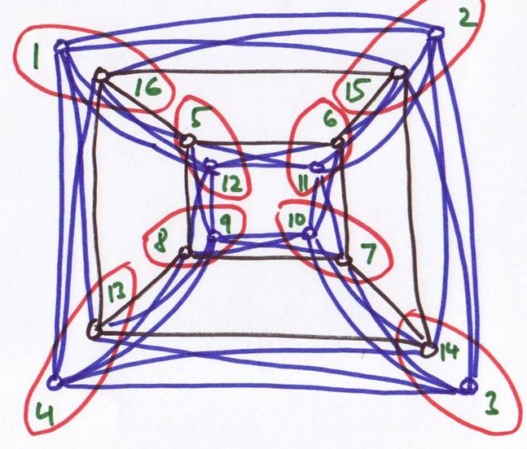
Distance magic labeling
Distance magic vertex labeling of a graph G with n vertices:
A bijection μ from the vertex set of G to {1, 2,…, n} such that sum w(x) of labels of the neighbors of each vertex (called the weight of x) is equal to the same constant m.

Slide 13
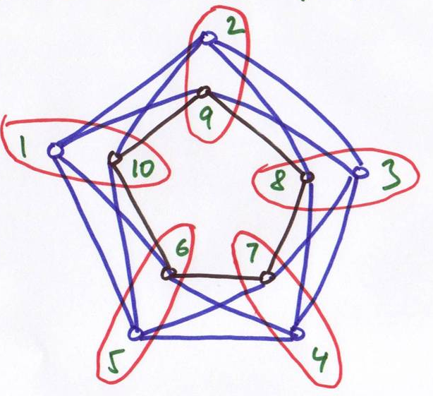
Distance magic labeling
Distance magic vertex labeling of a graph G with n vertices:
A bijection μ from the vertex set of G to {1, 2,…, n} such that sum w(x) of labels of the neighbors of each vertex (called the weight of x) is equal to the same constant m.

Slide 14
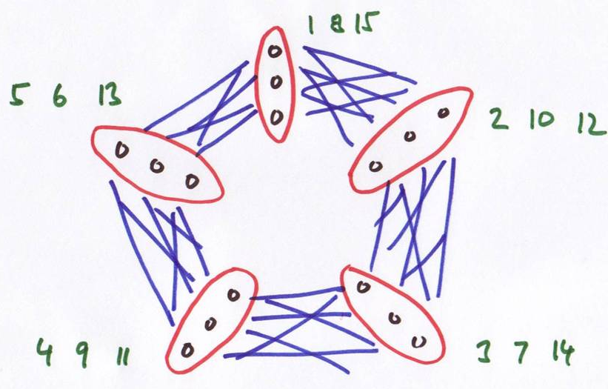
Distance magic labeling
Distance magic vertex labeling of a graph G with n vertices:
A bijection μ from the vertex set of G to {1, 2,…, n} such that sum w(x) of labels of the neighbors of each vertex (called the weight of x) is equal to the same constant m.

Slide 15
n-dimensional hypercube Q_{n}
Q_{n}
Vertex set:
All binary n-tuples
Edge set:
Two vertices adjacent iff they differ in exactly one position

Slide 16
n-dimensional hypercube Q_{n}
Q_{n}
Vertex set:
All binary n-tuples
Edge set:
Two vertices adjacent iff they differ in exactly one position

Slide 17
n-dimensional hypercube Q_{n}
Recursive definition of Q_{n}
Take two copies of Q_{n-1} and join the corresponding vertices by an edge
This is the cartesian product
Q_{n-1} ◻ K₂

Slide 18
n-dimensional hypercube Q_{n}
Recursive definition of Q_{n}
Take two copies of Q_{n-1} and join the corresponding vertices by an edge
This is the cartesian product
Q_{n-1} ◻ K₂

Slide 19
n-dimensional hypercube Q_{n}
Recursive definition of Q_{n}
Take two copies of Q_{n-1} and join the corresponding vertices by an edge
This is the cartesian product
Q_{n-1} ◻ K₂

Slide 20
n-dimensional hypercube Q_{n}
Recursive definition of Q_{n}
Take two copies of Q_{n-1} and join the corresponding vertices by an edge
This is the cartesian product
Q_{n-1} ◻ K₂

Slide 21
n-dimensional hypercube Q_{n}
Recursive definition of Q_{n}
Take two copies of Q_{n-1} and join the corresponding vertices by an edge
This is the cartesian product
Q_{n-1} ◻ K₂
or
Q_{n-2} ◻ C₄

Slide 22
n-dimensional hypercube Q_{n}
Recursive definition of Q_{n}
Take two copies of Q_{n-1} and join the corresponding vertices by an edge
This is the cartesian product
Q_{n-1} ◻ K₂
or
Q_{n-2} ◻ C₄

Slide 23
n-dimensional hypercube Q_{n}
Recursive definition of Q_{n}
Take two copies of Q_{n-1} and join the corresponding vertices by an edge
This is the cartesian product
Q_{n-1} ◻ K₂
or
Q_{n-2} ◻ C₄

Slide 24
Distance magic labeling of Q_{n}
Remark:
For k-regular graphs we can use for labels the set
{0, 1, 2,…, n–1} instead of
{1, 2,…, n}

Slide 25
Distance magic labeling of Q_{n}
Remark:
For k-regular graphs we can use for labels the set
{0, 1, 2,…, n–1} instead of
{1, 2,…, n}

Slide 26
Distance magic labeling of Q_{n}
Remark:
For k-regular graphs we can use for labels the set
{0, 1, 2,…, n–1} instead of
{1, 2,…, n} and define
μ' (x) = μ(x) – 1

Slide 27
Distance magic labeling of Q_{n}
Remark:
For k-regular graphs we can use for labels the set
{0, 1, 2,…, n–1} instead of
{1, 2,…, n} and define
μ' (x) = μ(x) – 1
Then we have
m ' = m – k

Slide 28
Distance magic labeling of Q_{n}

Slide 29
Distance magic labeling of Q_{n}
Small cases:
n = 1 NO

Slide 30
Distance magic labeling of Q_{n}
Small cases:
n = 1 NO
n = 2 YES

Slide 31
Distance magic labeling of Q_{n}
Small cases:
n = 1 NO
n = 2 YES
n = 3 NO

Slide 32
Distance magic labeling of Q_{n}
Small cases:
n = 1 NO
n = 2 YES
n = 3 NO
Conjecture?

Slide 33
Distance magic labeling of Q_{n}
Small cases:
n = 1 NO
n = 2 YES
n = 3 NO
Conjecture?
Q_{n} is distance magic if and only if n is even.
;-)

Slide 34
Distance magic labeling of Q_{n}
Theorem 1:
There is no r-regular DM graph for r odd.
Conjecture?
Q_{n} is distance magic if and only if n is even.
☺

Slide 35
Distance magic labeling of Q_{n}
Theorem 1:
There is no r-regular DM graph for r odd.
Conjecture?
Q_{n} is distance magic if and only if n is even.
☹

Slide 36
Distance magic labeling of Q_{n}
Theorem 1:
There is no r-regular DM graph for r odd.
Conjecture:
(Acharya, Rao, Singh, Parameswaran)
Q_{n} is not distance magic for any n except n = 2.

Slide 37
Distance magic labeling of Q_{n}
Theorem 1:
There is no r-regular DM graph for r odd.
Conjecture:
(Acharya, Rao, Singh, Parameswaran)
Q_{n} is not distance magic for any n except n = 2.
:-O

Slide 38
Distance magic labeling of Q_{n}
Theorem 1:
There is no r-regular DM graph for r odd.
Conjecture:
(Acharya, Rao, Singh, Parameswaran)
Q_{n} is not distance magic for any n except n = 2.
:-O (what?)

Slide 39
Distance magic labeling of Q_{n}
Theorem 1:
There is no r-regular DM graph for r odd.
Theorem 2:
Q_{n} is not distance magic for
n = 4k.
Conjecture:
(Acharya, Rao, Singh, Parameswaran)
Q_{n} is not distance magic for any n except n = 2.

Slide 40
Theorem 2: Q_{n} is not distance magic for n = 4k.
Proof: (By example for n = 8.)
Level i = all vertices at distance i from the vertex labeled 0

Slide 41
Theorem 2: Q_{n} is not distance magic for n = 4k.
Proof: (By example for n = 8.)
Level i = all vertices at distance i from the vertex labeled 0
S_{i} = sum of vertex labels at level i

Slide 42
Theorem 2: Q_{n} is not distance magic for n = 4k.
Proof: (By example for n = 8.)
Level i = all vertices at distance i from the vertex labeled 0
S_{i} = sum of vertex labels at level i
W_{i} = sum of vertex weights at level i

Slide 43
Theorem 2: Q_{n} is not distance magic for n = 4k.
Proof: (By example for n = 8.)
Level i = all vertices at distance i from the vertex labeled 0
S_{i} = sum of vertex labels at level i
W_{i} = sum of vertex weights at level i
W₃ = 56m
W₅ = 56m

Slide 44
Theorem 2: Q_{n} is not distance magic for n = 4k.
Proof: (By example for n = 8.)
Level i = all vertices at distance i from the vertex labeled 0
S_{i} = sum of vertex labels at level i
W_{i} = sum of vertex weights at level i
W₃ = 56m
W₅ = 56m

Slide 45
Theorem 2: Q_{n} is not distance magic for n = 4k.
Proof: (By example for n = 8.)
Level i = all vertices at distance i from the vertex labeled 0
S_{i} = sum of vertex labels at level i
W_{i} = sum of vertex weights at level i
W₃ = 56m = 4S₄ + 6S₂ and 6S₂ = 56m – 4S₄
W₅ = 56m = 4S₄ + 6S₆ and 6S₆ = 56m – 4S₄
Hence, S₂ = S₆.

Slide 46
Theorem 2: Q_{n} is not distance magic for n = 4k.
Proof: (By example for n = 8.)
Level i = all vertices at distance i from the vertex labeled 0
S_{i} = sum of vertex labels at level i
W_{i} = sum of vertex weights at level i
W₃ = 56m = 4S₄ + 6S₂ and 6S₂ = 56m – 4S₄
W₅ = 56m = 4S₄ + 6S₆ and 6S₆ = 56m – 4S₄
Hence, S₂ = S₆. Similarly,
W₁ = 8m = 2S₂ + 8S₀ and 8S₀ = 8m – 2S₂
W₇ = 8m = 2S₆ + 8S₈ and 8S₈ = 8m – 2S₆

Slide 47
Theorem 2: Q_{n} is not distance magic for n = 4k.
Proof: (By example for n = 8.)
Level i = all vertices at distance i from the vertex labeled 0
S_{i} = sum of vertex labels at level i
W_{i} = sum of vertex weights at level i
W₃ = 56m = 4S₄ + 6S₂ and 6S₂ = 56m – 4S₄
W₅ = 56m = 4S₄ + 6S₆ and 6S₆ = 56m – 4S₄
Hence, S₂ = S₆. Similarly,
W₁ = 8m = 2S₂ + 8S₀ and 8S₀ = 8m – 2S₂
W₇ = 8m = 2S₆ + 8S₈ and 8S₈ = 8m – 2S₆
But S₂ = S₆ and then S₀ = S₈.

Slide 48
Theorem 2: Q_{n} is not distance magic for n = 4k.
Proof: (By example for n = 8.)
Level i = all vertices at distance i from the vertex labeled 0
S_{i} = sum of vertex labels at level i
W_{i} = sum of vertex weights at level i
W₃ = 56m = 4S₄ + 6S₂ and 6S₂ = 56m – 4S₄
W₅ = 56m = 4S₄ + 6S₆ and 6S₆ = 56m – 4S₄
Hence, S₂ = S₆. Similarly,
W₁ = 8m = 2S₂ + 8S₀ and 8S₀ = 8m – 2S₂
W₇ = 8m = 2S₆ + 8S₈ and 8S₈ = 8m – 2S₆
But S₂ = S₆ and then S₀ = S₈.
Level 0 and level 8 contain just one vertex each (0 and x, resp.), we have µ(x) = 0, which is a contradiction.

Slide 49
Theorem 2*: Q_{n} is not distance magic for n = 4k+2.

Slide 50
Theorem 2*: Q_{n} is not distance magic for n = 4k+2, n ≥ 6.
Proved independently by
(C. Barrientos, E. Krop,
C. Raridan) and DF

Slide 51
Theorem 2*: Q_{n} is not distance magic for n = 4k+2, n ≥ 6.
Proved independently by
(C. Barrientos, E. Krop,
C. Raridan) and DF
(Un)fortunately, the proof
was WRONG!

Slide 52
Theorem 2*: Q_{n} is not distance magic for n = 4k+2, n ≥ 6.
Proved independently by
(C. Barrientos, E. Krop,
C. Raridan) and DF
(Un)fortunately, the proof
was WRONG!

Slide 53
Theorem 2*: Q_{n} is not distance magic for n = 4k+2, n ≥ 6.
Proved independently by
(C. Barrientos, E. Krop,
C. Raridan) and DF
(Un)fortunately, the proof
was WRONG!

Slide 54
Theorem 2*: Q_{n} is not distance magic for n = 4k+2, n ≥ 6.
Proved independently by
(C. Barrientos, E. Krop,
C. Raridan) and DF
(Un)fortunately, the proof
was WRONG!

Slide 55
Distance magic labeling of Q₆

Slide 56
Distance magic labeling of Q₆

Slide 57
Distance magic labeling of Q₆

Slide 58
Distance magic labeling of Q₆

Slide 59
Distance magic labeling of Q₆

Slide 60
Distance magic labeling of Q₆

Slide 61
Distance magic labeling of Q₆

Slide 62
Distance magic labeling of Q₆
6?!

Slide 63
Distance magic labeling of Q₆
6?!
“Isn’t it three too many,
Anton Pavlovich?”

Slide 64
Distance magic labeling of Q₆
Reduce Q₆ to Q₃

Slide 65
Distance magic labeling of Q₆

Slide 66
Distance magic labeling of Q₆

Slide 67
Distance magic labeling of Q₆

Slide 68
Distance magic labeling of Q₆

Slide 69
Distance magic labeling of Q₆

Slide 70
Distance magic labeling of Q₆
Vertex labels in 4 horizontal levels
13 | 12 | 10 | 11 |  | 16 | 17 | 23 | 22
63 | 62 | 56 | 57 |  | 34 | 35 | 37 | 36
2 | 3 | 5 | 4 |  | 31 | 30 | 24 | 25
48 | 49 | 55 | 54 |  | 45 | 44 | 42 | 43
58 | 59 | 61 | 60 |  | 39 | 38 | 32 | 33
8 | 9 | 15 | 14 |  | 21 | 20 | 18 | 19
53 | 52 | 50 | 51 |  | 40 | 41 | 47 | 46
7 | 6 | 0 | 1 |  | 26 | 27 | 29 | 28

Slide 71
Distance magic labeling of Q₆
Vertex labels in 4 horizontal levels |  |  |  |  |  |  |  |  |  | Sum of 4 neighbors in the same horizontal level
13 | 12 | 10 | 11 |  | 16 | 17 | 23 | 22 |  | 134 | 134 | 134 | 134 |  | 118 | 118 | 118 | 118
63 | 62 | 56 | 57 |  | 34 | 35 | 37 | 36 |  | 134 | 134 | 134 | 134 |  | 118 | 118 | 118 | 118
2 | 3 | 5 | 4 |  | 31 | 30 | 24 | 25 |  | 118 | 118 | 118 | 118 |  | 134 | 134 | 134 | 134
48 | 49 | 55 | 54 |  | 45 | 44 | 42 | 43 |  | 118 | 118 | 118 | 118 |  | 134 | 134 | 134 | 134
58 | 59 | 61 | 60 |  | 39 | 38 | 32 | 33 |  | 134 | 134 | 134 | 134 |  | 118 | 118 | 118 | 118
8 | 9 | 15 | 14 |  | 21 | 20 | 18 | 19 |  | 134 | 134 | 134 | 134 |  | 118 | 118 | 118 | 118
53 | 52 | 50 | 51 |  | 40 | 41 | 47 | 46 |  | 118 | 118 | 118 | 118 |  | 134 | 134 | 134 | 134
7 | 6 | 0 | 1 |  | 26 | 27 | 29 | 28 |  | 118 | 118 | 118 | 118 |  | 134 | 134 | 134 | 134

Slide 72
Distance magic labeling of Q₆
Sum of 2 neighbors in the same column |  |  |  |  |  |  |  |  |  | Sum of 4 neighbors in the same horizontal level
55 | 55 | 55 | 55 |  | 71 | 71 | 71 | 71 |  | 134 | 134 | 134 | 134 |  | 118 | 118 | 118 | 118
55 | 55 | 55 | 55 |  | 71 | 71 | 71 | 71 |  | 134 | 134 | 134 | 134 |  | 118 | 118 | 118 | 118
71 | 71 | 71 | 71 |  | 55 | 55 | 55 | 55 |  | 118 | 118 | 118 | 118 |  | 134 | 134 | 134 | 134
71 | 71 | 71 | 71 |  | 55 | 55 | 55 | 55 |  | 118 | 118 | 118 | 118 |  | 134 | 134 | 134 | 134
55 | 55 | 55 | 55 |  | 71 | 71 | 71 | 71 |  | 134 | 134 | 134 | 134 |  | 118 | 118 | 118 | 118
55 | 55 | 55 | 55 |  | 71 | 71 | 71 | 71 |  | 134 | 134 | 134 | 134 |  | 118 | 118 | 118 | 118
71 | 71 | 71 | 71 |  | 55 | 55 | 55 | 55 |  | 118 | 118 | 118 | 118 |  | 134 | 134 | 134 | 134
71 | 71 | 71 | 71 |  | 55 | 55 | 55 | 55 |  | 118 | 118 | 118 | 118 |  | 134 | 134 | 134 | 134

Slide 73
Distance magic labeling of Q₆
Sum of 2 neighbors in the same column |  |  |  |  |  |  |  |  |  | Sum of 4 neighbors in the same horizontal level
55 | 55 | 55 | 55 |  | 71 | 71 | 71 | 71 |  | 134 | 134 | 134 | 134 |  | 118 | 118 | 118 | 118
55 | 55 | 55 | 55 |  | 71 | 71 | 71 | 71 |  | 134 | 134 | 134 | 134 |  | 118 | 118 | 118 | 118
71 | 71 | 71 | 71 |  | 55 | 55 | 55 | 55 |  | 118 | 118 | 118 | 118 |  | 134 | 134 | 134 | 134
71 | 71 | 71 | 71 |  | 55 | 55 | 55 | 55 |  | 118 | 118 | 118 | 118 |  | 134 | 134 | 134 | 134
55 | 55 | 55 | 55 |  | 71 | 71 | 71 | 71 |  | 134 | 134 | 134 | 134 |  | 118 | 118 | 118 | 118
55 | 55 | 55 | 55 |  | 71 | 71 | 71 | 71 |  | 134 | 134 | 134 | 134 |  | 118 | 118 | 118 | 118
71 | 71 | 71 | 71 |  | 55 | 55 | 55 | 55 |  | 118 | 118 | 118 | 118 |  | 134 | 134 | 134 | 134
71 | 71 | 71 | 71 |  | 55 | 55 | 55 | 55 |  | 118 | 118 | 118 | 118 |  | 134 | 134 | 134 | 134
m = 55 + 134 = 71 + 118 = 189

Slide 74
Distance magic labeling of Q_{4k+2}
Problem:
Find a distance magic labeling of Q_{4k+2} for k >1

Slide 75
Distance magic labeling of Q_{4k+2}
Problem:
Find a distance magic labeling of Q_{4k+2} for k >1
Theorem (P. Gregor):
There is a distance magic labeling of Q_{4k+2} for k >1

Slide 76
Distance magic labeling of Q_{4k+2}
Proof:
Based on some matrix application and a group distance labeling.
Theorem (P. Gregor):
There is a distance magic labeling of Q_{4k+2} for k >1

Slide 77
Distance magic labeling of Q_{4k+2}
Proof:
Based on some matrix application and a group distance labeling.
What?
Theorem (P. Gregor):
There is a distance magic labeling of Q_{4k+2} for k >1

Slide 78
Distance magic labeling of Q_{4k+2}
Proof:
Based on some matrix application and a group distance labeling.
What? Group distance magic labeling?
Theorem (P. Gregor):
There is a distance magic labeling of Q_{4k+2} for k >1

Slide 80
Distance magic labeling of Q₄ revisited
We know that distance magic labeling of Q₄ does not exist.

Slide 81
Distance magic labeling of Q₄ revisited
We know that distance magic labeling of Q₄ does not exist.
Couldn’t we find a less restrictive labeling?

Slide 82
Distance magic labeling of Q₄ revisited
Definition:
Let G be a graph with n vertices and G a group with n elements. We call a bijection
g: V(G)  G
G-distance magic labeling if
w(x) = m
for some m in G.
We know that distance magic labeling of Q₄ does not exist.
Couldn’t we find a less restrictive labeling?

Slide 83
Distance magic labeling of Q₄ revisited
Definition:
Let G be a graph with n vertices and G a group with n elements. We call a bijection
g: V(G)  G
G-distance magic labeling if
w(x) = m
for some m in G.
We know that distance magic labeling of Q₄ does not exist.
Couldn’t we find a less restrictive labeling?
Maybe Z₁₆-distance magic labeling?

Slide 84
Z_{n}-distance magic labeling of Q_{2k+1}

Slide 85
Z_{n}-distance magic labeling of Q_{2k+1}
Theorem: There is no
r-regular distance magic
graph for r odd.

Slide 86
Z_{n}-distance magic labeling of Q_{2k+1}
Theorem: There is no
r-regular distance magic
graph for r odd.
Theorem: (Sylwia Cichacz)
There is no r-regular
Z_{n}-distance magic graph
for r odd.

Slide 87
G-distance magic labeling of Q_{2k+1}
Theorem: There is no
r-regular distance magic
graph for r odd.
Theorem: (Sylwia Cichacz)
There is no r-regular
Z_{n}-distance magic graph
for r odd.
Theorem:
There is no r-regular
G -distance magic graph
for r odd and any Abelian group G.

Slide 88
Z₁₆-distance magic labeling of Q₄
Definition:
Let G be a graph with n vertices and G a group with n elements. We call a bijection
g: V(G)  G
G-distance magic labeling if
w(x) = m
for some m in G.
We know that distance magic labeling of Q₄ does not exist.
Couldn’t we find a less restrictive labeling?
Maybe Z₁₆-distance magic labeling?

Slide 89
Z₁₆-distance magic labeling of Q₄
Z₁₆-distance magic labeling
 | 13 | 12 | 10 | 11
 | 15 | 14 | 8 | 9
 | 2 | 3 | 5 | 4
 | 0 | 1 | 7 | 6

Slide 90
Z₁₆-distance magic labeling of Q₄
Z₁₆-distance magic labeling
 | 0 | 1 | 7 | 6
11 | 13 | 12 | 10 | 11 | 13
9 | 15 | 14 | 8 | 9 | 15
4 | 2 | 3 | 5 | 4 | 2
6 | 0 | 1 | 7 | 6 | 0
 | 13 | 12 | 10 | 11

Slide 91
Z₁₆-distance magic labeling of Q₄
Z₁₆-distance magic labeling
 | 0 | 1 | 7 | 6
11 | 13 | 12 | 10 | 11 | 13
9 | 15 | 14 | 8 | 9 | 15
4 | 2 | 3 | 5 | 4 | 2
6 | 0 | 1 | 7 | 6 | 0
 | 13 | 12 | 10 | 11
 | w(x)

Slide 92
Z₁₆-distance magic labeling of Q₄
Z₁₆-distance magic labeling
 | 0 | 1 | 7 | 6
11 | 13 | 12 | 10 | 11 | 13
9 | 15 | 14 | 8 | 9 | 15
4 | 2 | 3 | 5 | 4 | 2
6 | 0 | 1 | 7 | 6 | 0
 | 13 | 12 | 10 | 11
 | w(x)
 |  | 6

Slide 93
Z₁₆-distance magic labeling of Q₄
Z₁₆-distance magic labeling
 | 0 | 1 | 7 | 6
11 | 13 | 12 | 10 | 11 | 13
9 | 15 | 14 | 8 | 9 | 15
4 | 2 | 3 | 5 | 4 | 2
6 | 0 | 1 | 7 | 6 | 0
 | 13 | 12 | 10 | 11
 | w(x)
 |  |  |  | 6
 |  | 6

Slide 94
Z₁₆-distance magic labeling of Q₄
Z₁₆-distance magic labeling
 | 0 | 1 | 7 | 6
11 | 13 | 12 | 10 | 11 | 13
9 | 15 | 14 | 8 | 9 | 15
4 | 2 | 3 | 5 | 4 | 2
6 | 0 | 1 | 7 | 6 | 0
 | 13 | 12 | 10 | 11
 | w(x)
 |  |  |  | 6
 |  | 6
 |  |  | 6

Slide 95
Z₁₆-distance magic labeling of Q₄
Z₁₆-distance magic labeling
with m = 6
 | 0 | 1 | 7 | 6
11 | 13 | 12 | 10 | 11 | 13
9 | 15 | 14 | 8 | 9 | 15
4 | 2 | 3 | 5 | 4 | 2
6 | 0 | 1 | 7 | 6 | 0
 | 13 | 12 | 10 | 11
 | w(x)
 | 6 | 6 | 6 | 6
 | 6 | 6 | 6 | 6
 | 6 | 6 | 6 | 6
 | 6 | 6 | 6 | 6

Slide 96
Z₁₆-distance magic labeling of Q₄
Z₁₆-distance magic labeling
with m = 6
How about another constant?
 | 0 | 1 | 7 | 6
11 | 13 | 12 | 10 | 11 | 13
9 | 15 | 14 | 8 | 9 | 15
4 | 2 | 3 | 5 | 4 | 2
6 | 0 | 1 | 7 | 6 | 0
 | 13 | 12 | 10 | 11
 | w(x)

Slide 97
Z₁₆-distance magic labeling of Q₄
Z₁₆-distance magic labeling
with m = 6
How about another constant?
Define
g_{i}(x) = g(x) + i
 | 0 | 1 | 7 | 6
11 | 13 | 12 | 10 | 11 | 13
9 | 15 | 14 | 8 | 9 | 15
4 | 2 | 3 | 5 | 4 | 2
6 | 0 | 1 | 7 | 6 | 0
 | 13 | 12 | 10 | 11
 | w(x)

Slide 98
Z₁₆-distance magic labeling of Q₄
Z₁₆-distance magic labeling
with m = 6
How about another constant?
Define
g_{i}(x) = g(x) + i
Then
w_{i}(x) = w(x) + 4i
 | 0 | 1 | 7 | 6
11 | 13 | 12 | 10 | 11 | 13
9 | 15 | 14 | 8 | 9 | 15
4 | 2 | 3 | 5 | 4 | 2
6 | 0 | 1 | 7 | 6 | 0
 | 13 | 12 | 10 | 11
 | w(x)

Slide 99
Z₁₆-distance magic labeling of Q₄
Z₁₆-distance magic labeling
with m = 6
How about another constant?
Define
g_{i}(x) = g(x) + i
Then
w_{i}(x) = w(x) + 4i
Say i = 1
 | 0 | 1 | 7 | 6
11 | 13 | 12 | 10 | 11 | 13
9 | 15 | 14 | 8 | 9 | 15
4 | 2 | 3 | 5 | 4 | 2
6 | 0 | 1 | 7 | 6 | 0
 | 13 | 12 | 10 | 11
 | w(x)

Slide 100
Z₁₆-distance magic labeling of Q₄
Z₁₆-distance magic labeling
with m = 6
How about another constant?
Define
g_{i}(x) = g(x) + i
Then
w_{i}(x) = w(x) + 4i
Say i = 1
 | 1 | 2 | 8 | 7
12 | 14 | 13 | 11 | 12 | 14
10 | 0 | 15 | 9 | 10 | 0
5 | 3 | 4 | 6 | 5 | 3
7 | 1 | 2 | 8 | 7 | 1
 | 14 | 13 | 11 | 12
 | w(x)

Slide 101
Z₁₆-distance magic labeling of Q₄
Z₁₆-distance magic labeling
with m = 6
How about another constant?
Define
g_{i}(x) = g(x) + i
Then
w_{i}(x) = w(x) + 4i
Say i = 1. Then m = 10.
 | 1 | 2 | 8 | 7
12 | 14 | 13 | 11 | 12 | 14
10 | 0 | 15 | 9 | 10 | 0
5 | 3 | 4 | 6 | 5 | 3
7 | 1 | 2 | 8 | 7 | 1
 | 14 | 13 | 11 | 12
 | w(x)
 | 10 | 10 | 10 | 10
 | 10 | 10 | 10 | 10
 | 10 | 10 | 10 | 10
 | 10 | 10 | 10 | 10

Slide 102
Z₁₆-distance magic labeling of Q₄
Z₁₆-distance magic labeling
with m = 6
Using i = 0, 1, 2, 3, we can do it for m = 2, 6, 10, 14
Can we do it for other constants than 2, 6, 10, 14?
 | 1 | 2 | 8 | 7
12 | 14 | 13 | 11 | 12 | 14
10 | 0 | 15 | 9 | 10 | 0
5 | 3 | 4 | 6 | 5 | 3
7 | 1 | 2 | 8 | 7 | 1
 | 14 | 13 | 11 | 12
 | w(x)
 | 10 | 10 | 10 | 10
 | 10 | 10 | 10 | 10
 | 10 | 10 | 10 | 10
 | 10 | 10 | 10 | 10

Slide 103
Z₁₆-distance magic labeling of Q₄
Z₁₆-distance magic labeling
with m = 6
Using i = 0, 1, 2, 3, we can do it for m = 2, 6, 10, 14
Can we do it for other constants than 2, 6, 10, 14?
No.
 | 1 | 2 | 8 | 7
12 | 14 | 13 | 11 | 12 | 14
10 | 0 | 15 | 9 | 10 | 0
5 | 3 | 4 | 6 | 5 | 3
7 | 1 | 2 | 8 | 7 | 1
 | 14 | 13 | 11 | 12
 | w(x)
 | 10 | 10 | 10 | 10
 | 10 | 10 | 10 | 10
 | 10 | 10 | 10 | 10
 | 10 | 10 | 10 | 10

Slide 104
Z₁₆-distance magic labeling of Q₄
Z₁₆-distance magic labeling
with m = 6
Using i = 0, 1, 2, 3, we can do it for m = 2, 6, 10, 14
Can we do it for other constants than 2, 6, 10, 14?
No. For 4-regular graphs with 0 (mod 4) vertices, m is always 2 (mod 4).
 | 1 | 2 | 8 | 7
12 | 14 | 13 | 11 | 12 | 14
10 | 0 | 15 | 9 | 10 | 0
5 | 3 | 4 | 6 | 5 | 3
7 | 1 | 2 | 8 | 7 | 1
 | 14 | 13 | 11 | 12
 | w(x)
 | 10 | 10 | 10 | 10
 | 10 | 10 | 10 | 10
 | 10 | 10 | 10 | 10
 | 10 | 10 | 10 | 10

Slide 105
Z_{n}-distance magic labeling of Q_{2k}?
Z₁₆-distance magic labeling
of Q₄ with m = 2, 6, 10, 14
Recall that Q₂ allows a
Z₄-distance magic labeling
Problem:
Does there exist a
Z_{n}-distance magic labeling of Q_{2k} for n = 2^{2k} = 4^{k} and
k > 2?
Or in general a G -distance magic labeling of Q_{4k}?

Slide 106
Z_{n}-distance magic labeling of Q_{2k}?
Z₁₆-distance magic labeling
of Q₄ with m = 2, 6, 10, 14
Recall that Q₂ allows a
Z₄-distance magic labeling
Problem:
Does there exist a
Z_{n}-distance magic labeling of Q_{2k} for n = 2^{2k} = 4^{k} and
k > 2?
Or in general a G -distance magic labeling of Q_{4k}?

Slide 107
So is there a G-distance magic labeling of Q_{2k} with k ≥ 3 for some group G?

Slide 108
Z₂×Z₂×…×Z₂-distance magic labeling of Q_{2k}
Observation:
There exists a G-distance magic labeling of Q_{2k} for
k ≥ 1 and G = Z₂×Z₂×…×Z₂.

Slide 109
Z₂×Z₂×…×Z₂-distance magic labeling of Q_{2k}
Observation:
There exists a G-distance magic labeling of Q_{2k} for
k ≥ 1 and G = Z₂×Z₂×…×Z₂.
Proof:
Take the “natural” labeling.
The neighbors of x = x₁x₂…x_{2k} are
x^{i} = x₁x₂…x_{i–1} (x_{i}+1) x_{i+1}…x_{2k}
for i = 1,2,…,2k.

Slide 110
Z₂×Z₂×…×Z₂-distance magic labeling of Q_{2k}
Observation:
There exists a G-distance magic labeling of Q_{2k} for
k ≥ 1 and G = Z₂×Z₂×…×Z₂.
Proof:
Take the “natural” labeling.
The neighbors of x = x₁x₂…x_{2k} are
x^{i} = x₁x₂…x_{i–1} (x_{i}+1) x_{i+1}…x_{2k}
for i = 1,2,…,2k.
Then
x¹+x² =
= (2x₁+1) (2x₂+1)(2x₃)…(2x_{2k}) =
= 1100…0

Slide 111
Z₂×Z₂×…×Z₂-distance magic labeling of Q_{2k}
Observation:
There exists a G-distance magic labeling of Q_{2k} for
k ≥ 1 and G = Z₂×Z₂×…×Z₂.
Proof:
Take the “natural” labeling.
The neighbors of x = x₁x₂…x_{2k} are
x^{i} = x₁x₂…x_{i–1} (x_{i}+1) x_{i+1}…x_{2k}
for i = 1,2,…,2k.
Then
x¹+x² =
= (2x₁+1) (2x₂+1)(2x₃)…(2x_{2k}) =
= 1100…0
Similarly we have
x^{2i–1}+x^{2i} =
= (2x₁)…(2x_{2i–1}+1) (2x_{2i}+1) …(2x_{2k}) =
= 00…0110…0

Slide 112
Z₂×Z₂×…×Z₂-distance magic labeling of Q_{2k}
Observation:
There exists a G-distance magic labeling of Q_{2k} for
k ≥ 1 and G = Z₂×Z₂×…×Z₂.
Proof:
Take the “natural” labeling.
The neighbors of x = x₁x₂…x_{2k} are
x^{i} = x₁x₂…x_{i–1} (x_{i}+1) x_{i+1}…x_{2k}
for i = 1,2,…,2k.
Then
x¹+x² =
= (2x₁+1) (2x₂+1)(2x₃)…(2x_{2k}) =
= 1100…0
Similarly we have
x^{2i–1}+x^{2i} =
= (2x₁)…(2x_{2i–1}+1) (2x_{2i}+1) …(2x_{2k}) =
= 00…0110…0
and the sum of all neighbors is
111…1.

Slide 113
Z_{n}-distance magic labeling of Q_{2k}

Slide 114
Z_{n}-distance magic labeling of Q_{2k}
Theorem:
There exists a Z_{n}-distance magic labeling of Q_{2k} for k ≥ 1 and n = 4^{k} .

Slide 115
Z_{n}-distance magic labeling of Q_{2k}
Theorem:
There exists a Z_{n}-distance magic labeling of Q_{2k} for k ≥ 1 and n = 4^{k} .
Proof:
Recursive construction.

Slide 116
Z_{n}-distance magic labeling of Q_{2k}
Theorem:
There exists a Z_{n}-distance magic labeling of Q_{2k} for k ≥ 1 and n = 4^{k} .
Proof:
Recursive construction.
To label Q_{2k+2} :
take four copies of Q_{2k}
multiply the labels by 4 or −4
in each copy, add to the label of the four images of a vertex x elements 0, 1, 2, 3 of Z_{4n}, resp.

Slide 117
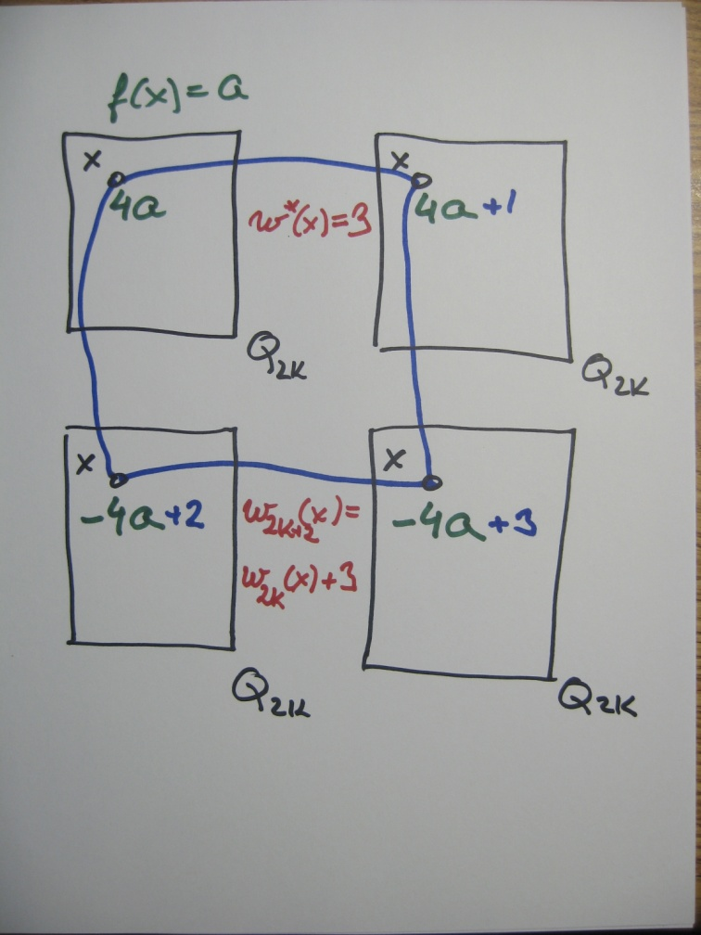
Z_{n}-distance magic labeling of Q_{2k}
To label Q_{2k+2} :
take four copies of Q_{2k}
multiply the labels by 4 or −4
in each copy, add to the label of the four images of a vertex x elements 0, 1, 2, 3 of Z_{4n}, resp.

Slide 118
Is there a G-distance magic labeling of Q_{2k} with k ≥ 3 for other groups G?

Slide 119
Is there a G-distance magic labeling of Q_{2k} with k ≥ 3 for other groups G?
Theorem (??):
There exists a G-distance magic labeling of Q_{2k} for k ≥ 1 and any Abelian group G of order n = 4^{k} .

Slide 120
Is there a G-distance magic labeling of Q_{2k} with k ≥ 3 for other groups G?
Theorem (??):
There exists a G-distance magic labeling of Q_{2k} for k ≥ 1 and any Abelian group G of order n = 4^{k} .
Proof:
Recursive construction similar to the previous one.

Slide 122
Z_{mk}-distance magic labeling of C_{m} □ C_{k}
Problem:
Does there exist a
Z_{mk}-distance magic labeling of C_{m} ◻ C_{k} ?

Slide 123
Z_{mk}-distance magic labeling of C_{m} □ C_{k}
Problem:
Does there exist a
Z_{mk}-distance magic labeling of C_{m} ◻ C_{k} ?
Theorem:
(Rao, Singh, Parameswaran)
G =C_{m} ◻ C_{k} is distance magic if and only if m = k = 4s + 2

Slide 124
Z_{mk}-distance magic labeling of C_{m} □ C_{k}
Problem:
Does there exist a
Z_{mk}-distance magic labeling of C_{m} ◻ C_{k} ?
Theorem:
(Rao, Singh, Parameswaran)
G =C_{m} ◻ C_{k} is distance magic if and only if m = k = 4s + 2
Theorem:
There exists a Z_{mk}-distance magic labeling of C_{m} ◻ C_{k}
if and only if mk is even.

Slide 125
Z_{mk}-distance magic labeling of C_{m} □ C_{k}
Theorem:
There exists a Z_{mk}-distance magic labeling of C_{m} ◻ C_{k}
if and only if mk is even.

Slide 126
Z_{mk}-distance magic labeling of C_{m} □ C_{k}
Proof:

Slide 127
Z_{mk}-distance magic labeling of C_{m} □ C_{k}
Proof:

Slide 128
Z_{mk}-distance magic labeling of C_{m} □ C_{k}
Proof:

Slide 129
Z_{mk}-distance magic labeling of C_{m} □ C_{k}
Proof:

Slide 130
Z_{mk}-distance magic labeling of C_{m} □ C_{k}
Proof:

Slide 131
Z_{mk}-distance magic labeling of C_{m} □ C_{k}
Proof: Diagonal length is
l = lcm(m,k)

Slide 132
Z_{mk}-distance magic labeling of C_{m} □ C_{k}
 | x₁₂
x₂₁ | Σ | x₂₃
 | x₃₂
Proof: Diagonal length is
l = lcm(m,k)

Slide 133
Z_{mk}-distance magic labeling of C_{m} □ C_{k}
 | x₁₂
x₂₁ | Σ | x₂₃
 | x₃₂ | Σ | x₃₄
 |  | x₄₃
Proof: Diagonal length is
l = lcm(m,k)

Slide 134
Z_{mk}-distance magic labeling of C_{m} □ C_{k}
 | x₁₂
x₂₁ | Σ | x₂₃
 | x₃₂ | Σ | x₃₄
 |  | x₄₃
Proof: Diagonal length is
l = lcm(m,k)
x₂₁+ x₁₂= x₄₃+ x₃₄= …

Slide 135
Z_{mk}-distance magic labeling of C_{m} ×C_{k}
 | x₁₂
x₂₁ | Σ | x₂₃
 | x₃₂ | Σ | x₃₄
 |  | x₄₃
Proof: Diagonal length is
l = lcm(m,k)
x₂₁+ x₁₂= x₄₃+ x₃₄= …
but when l is odd
…=x₃₂+ x₂₃= x₅₄+ x₄₅=…

Slide 136
Z_{mk}-distance magic labeling of C_{m} ×C_{k}
Proof: Diagonal length is
l = lcm(m,k)
x₂₁+ x₁₂= x₄₃+ x₃₄= …
but when l is odd
…=x₃₂+ x₂₃= x₅₄+ x₄₅=…
so x_{ij}+ x_{i+1,j-1}= Σ/2
 |  | x₂₃
 | x₃₂ | Σ/2

Slide 137
Z_{mk}-distance magic labeling of C_{m} □ C_{k}
Proof: Diagonal length is
l = lcm(m,k)
x₂₁+ x₁₂= x₄₃+ x₃₄= …
but when l is odd
…=x₃₂+ x₂₃= x₅₄+ x₄₅=…
so x_{ij}+ x_{i+1,j-1}= Σ/2
but x_{i,j+2}+ x_{i+1,j-1}= Σ/2
 |  | x₂₃
 |  | Σ/2 | x₃₄

Slide 138
Z_{mk}-distance magic labeling of C_{m} □ C_{k}
Proof: Diagonal length is
l = lcm(m,k)
x₂₁+ x₁₂= x₄₃+ x₃₄= …
but when l is odd
…=x₃₂+ x₂₃= x₅₄+ x₄₅=…
so x_{ij}+ x_{i+1,j-1}= Σ/2
but x_{i,j+2}+ x_{i+1,j-1}= Σ/2
and x_{i,j+2} = x_{i,j}
 |  | x₂₃
 | x₃₂ | Σ/2 | x₃₄

Slide 139
Z_{mk}-distance magic labeling of C_{m} □ C_{k}
Proof: Diagonal length is
l = lcm(m,k)
x₂₁+ x₁₂= x₄₃+ x₃₄= …
but when l is odd
…=x₃₂+ x₂₃= x₅₄+ x₄₅=…
so x_{ij}+ x_{i+1,j-1}= Σ/2
but x_{i,j+2}+ x_{i+1,j-1}= Σ/2
and x_{i,j+2} = x_{i,j}
Contradiction!
 |  | x₂₃
 | x₃₂ | Σ/2 | x₃₄

Slide 140
Z_{mk}-distance magic labeling of C_{m} □ C_{k}
Proof: Diagonal length is
l = lcm(m,k)
Hence, mk cannot be odd.
 |  | x₂₃
 | x₃₂ | Σ/2 | x₃₄

Slide 141
Z_{mk}-distance magic labeling of C_{m} □ C_{k}
0
 |  | h
 |  |  |  | 2h
Proof:
When n=mk even, l is even.
Find a subgroup of Z_{n} of order l/2, say H = <h> .
Then h = 2n/l.
Fill half of a diagonal by H

Slide 142
Z_{mk}-distance magic labeling of C_{m} □ C_{k}
0
 | n–1
 |  | h
 |  |  | –h–1
 |  |  |  | 2h
 |  |  |  |  | …
Proof:
When n=mk even, l is even.
Find a subgroup of Z_{n} of order l/2, say H = <h> .
Then h = 2n/l.
Fill half of a diagonal by H, and the rest by coset H – 1 going “backwards.”

Slide 143
Z_{mk}-distance magic labeling of C_{m} □ C_{k}
0 | n–1
n–1 | n–1 | h–1
 | h–1 | h | n–1
 |  | n–1 | –h–1 | h–1
 |  |  | h–1 | 2h | n–1
 |  |  |  | n–1 | …
 |  |  |  |  | h–1
Proof:
When n=mk even, l is even.
Find a subgroup of Z_{n} of order l/2, say H = <h> .
Then h = 2n/l.
Fill half of a diagonal by H, and the rest by coset H – 1 going “backwards.”

Slide 144
Z_{mk}-distance magic labeling of C_{m} □ C_{k}
0 | n–1
n–1 | n–1 | h–1
 | h–1 | h | n–1
 |  | n–1 | –h–1 | h–1
 |  |  | h–1 | 2h | n–1
 |  |  |  | n–1 | …
 |  |  |  |  | h–1
Proof:
When n=mk even, l is even.
Find a subgroup of Z_{n} of order l/2, say H = <h> .
Now fill other diagonals carefully by cosets
H+i and H–i–1
to obtain the same sums,
n–1 and h–1.

Slide 145
Z_{mk}-distance magic labeling of C_{m} □ C_{k}
0 | n–1
n–1 | n–1 | h–1
 | h–1 | h | n–1
 |  | n–1 | –h–1 | h–1
 |  |  | h–1 | 2h | n–1
 |  |  |  | n–1 | …
 |  |  |  |  | h–1
Proof:
When n=mk even, l is even.
Find a subgroup of Z_{n} of order l/2, say H = <h> .
Now fill other diagonals carefully by cosets
H+i and H–i–1
to obtain the same sums,
n–1 and h–1. Then Σ = h–2.

Slide 146
Z_{mk}-distance magic labeling of C_{m} □ C_{k}
0 | n–1
n–1 | n–1 | h–1
 | h–1 | h | n–1
 |  | n–1 | –h–1 | h–1
 |  |  | h–1 | 2h | n–1
 |  |  |  | n–1 | …
 |  |  |  |  | h–1
Proof:
When n=mk even, l is even.
Find a subgroup of Z_{n} of order l/2, say H = <h> .
Now fill other diagonals carefully by cosets
H+i and H–i–1
to obtain the same sums,
n–1 and h–1. Then Σ = h–2.

Slide 147
Z_{mk}-distance magic labeling of C_{m} □ C_{k}
0 | n–1
n–1 | n–1 | h–1
 | h–1 | h | n–1
 |  | n–1 | –h–1 | h–1
 |  |  | h–1 | 2h | n–1
 |  |  |  | n–1 | …
 |  |  |  |  | h–1
Remark:
For n=mk ≡ 0 (mod 4), we have always Σ ≡ 2 (mod 4).
For n=mk ≡ 2 (mod 4), we have Σ ≡ 0 (mod 4).

Slide 148
Z_{mk}-distance magic labeling of C_{m} □C_{k}
0 | n–1
n–1 | n–1 | h–1
 | h–1 | h | n–1
 |  | n–1 | –h–1 | h–1
 |  |  | h–1 | 2h | n–1
 |  |  |  | n–1 | …
 |  |  |  |  | h–1
Remark:
For n=mk ≡ 0 (mod 4), we have always Σ ≡ 2 (mod 4).
For n=mk ≡ 2 (mod 4), we have Σ ≡ 0 (mod 4).
Theorem: There is no
r-regular DM graph with n
vertices for r ≡ n ≡ 2 mod 4.

Slide 149
G-distance magic labeling of C_{m} □C_{k}
Theorem:
(Rao, Singh, Parameswaran)
G =C_{m} ◻ C_{k} is distance magic if and only if m = k = 4s + 2
Theorem:
There exists a Z_{mk}-distance magic labeling of C_{m} ◻ C_{k}
if and only if mk is even.
Theorem (Sylwia):
There exists a G-distance magic labeling of C_{m} ◻ C_{k}
if mk is even and G = Z_{l} × A where l ≡ 0 mod lcm(m,k).

Slide 150
G-distance magic labeling of C_{m} □C_{k}
Theorem:
(Rao, Singh, Parameswaran)
G =C_{m} ◻ C_{k} is distance magic if and only if m = k = 4s + 2
Theorem:
There exists a Z_{mk}-distance magic labeling of C_{m} ◻ C_{k}
if and only if mk is even.
Theorem (Sylwia):
There exists a G-distance magic labeling of C_{m} ◻ C_{k}
if mk is even and G = Z_{l} × A where l ≡ 0 mod lcm(m,k).
Observation:
There exists a G-distance magic labeling of C₁₂ ◻ C₃₆
by G = Z₆ × Z₆ × Z₆ × Z₂.

Slide 152
Thank you!

